Slide 1
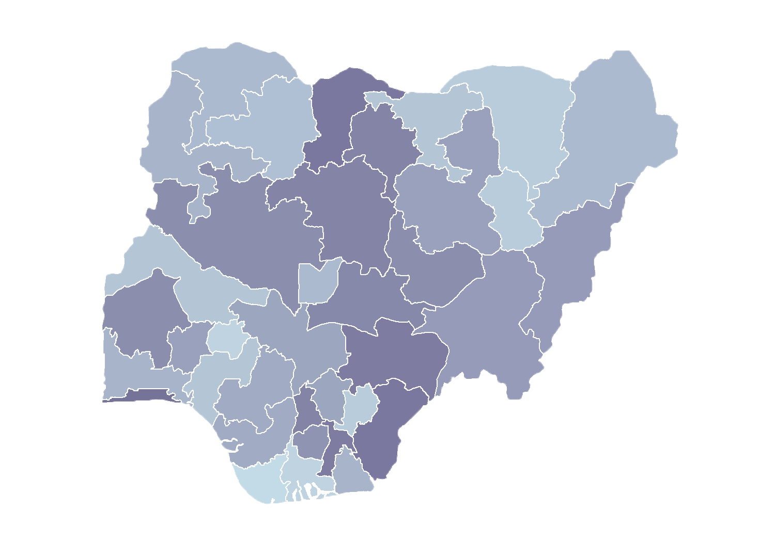
Module 1.2
Demonstration of the HFR Public Portal
Rollout of Health Facility Registry/Master Facility List for States and Local Government Areas in Nigeria
June 2019

Slide 2
Outline
Introduction
Home menu
Statistics
Facilities list
Data downloads
Resources
Activity

Slide 3
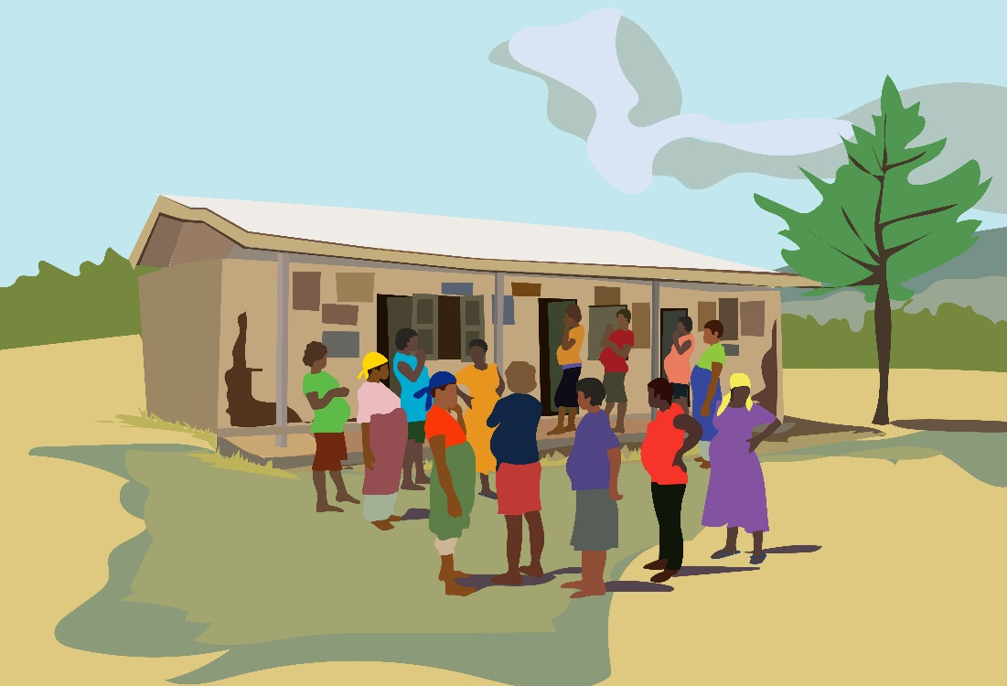
Home

Slide 4
Introduction
Training server URL
https://hfr-testing.health.gov.ng

Slide 5
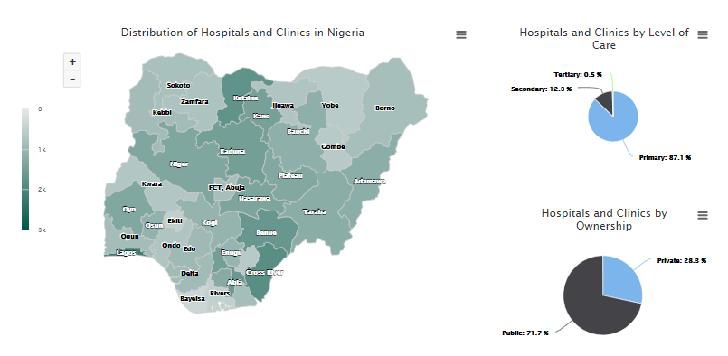
Home
1
2
3
1. Shows hospitals and clinics in each state
2. Shows hospitals and clinics by level of care
3. Shows hospitals and clinics by ownership

Slide 6
Home
Shows percentage of hospitals and clinics with geographic coordinates

Slide 7
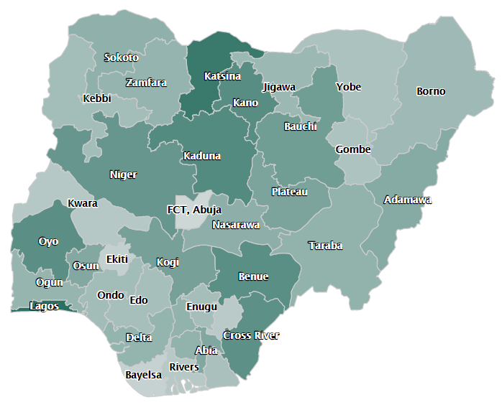
Home: Map
Interactive map displaying facility density
Which two states have the highest number of facilities?
To view state map details, click it
(e.g., Abia).
Notes:
Q1: Lagos (2167) and Cross River(1843)

Slide 8
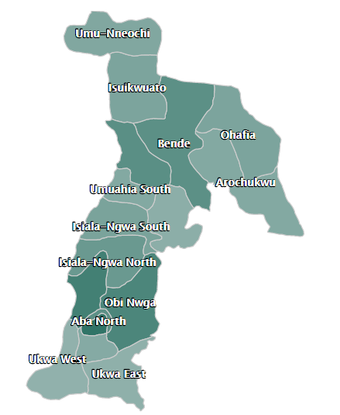
Home: Map
Abia State
To view LGA details, click it.
Which local government area (LGA) has the most facilities?
Notes:
Q1: Aba North (150)
- Click on Obi Ngwa LGA, to view details in google map

Slide 9
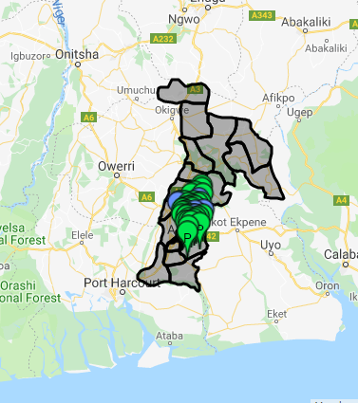
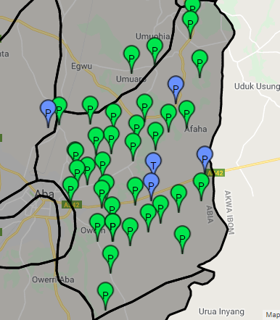
Home: Map
Obi Ngwa LGA
Click on the facility to see details.
Notes:
The first map shows Abia state
Use the zoom button to get a close up of Obi Ngwa LGA
Notice the different demarcations – what do you notice about the markers?
Green = public
Blue = private
P = primary
T = tertiary
S = secondary
Click on any facility to see the details of the facility

Slide 10
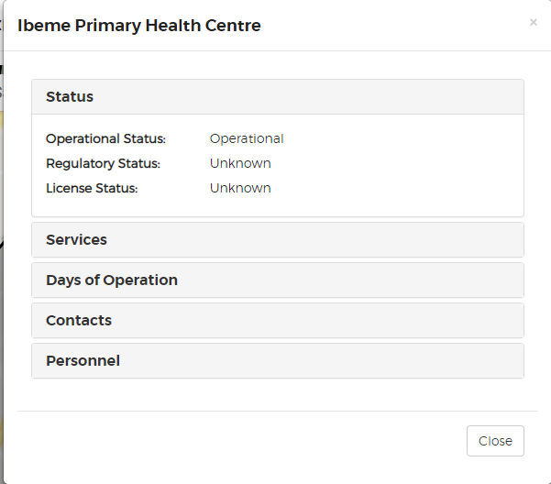
Home: Map
Facility details on map

Slide 11
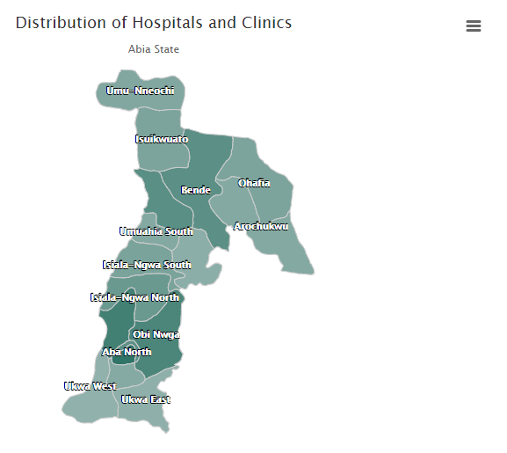
Quick tips
Download images
Anytime you see the three bars, click!
Available to print or download as PNG, JPED, PDG or SVG

Slide 12
Statistics
Summary tables
Notes:
After looking at home page, let us go to statistics.
Statistics has three submenu
Summary tables
Summary charts
Population index

Slide 13
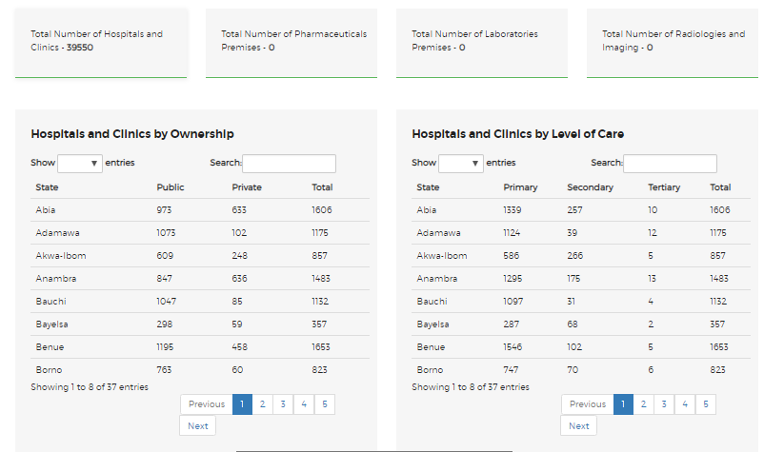
Summary tables

Slide 14
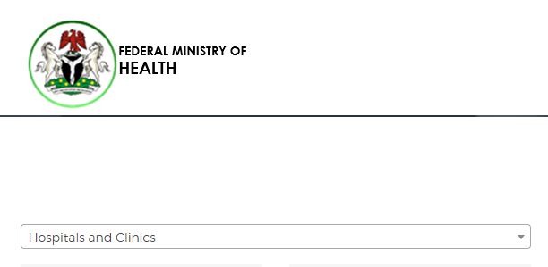
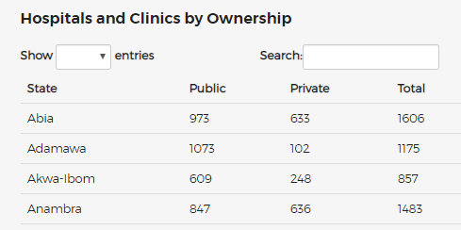
Summary tables
Abia State has 1,606 hospitals and clinics broken down by type: public (973) and private (633).

Slide 15
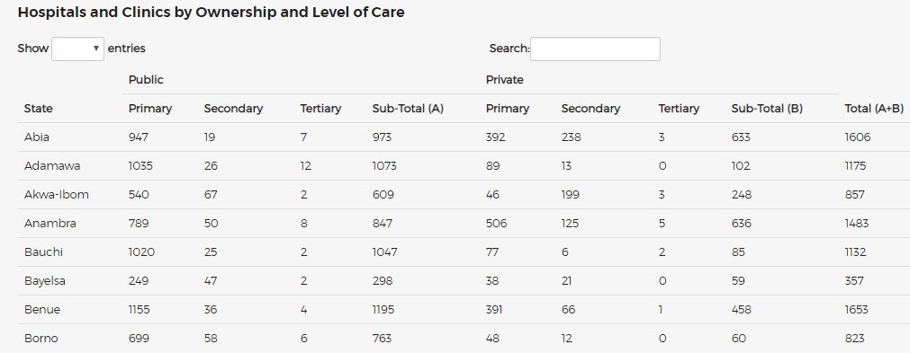
Summary tables cross-tab
Ownership and level of care

Slide 16
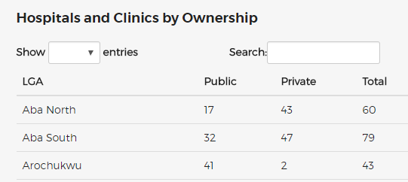
Summary tables: Filter
To produce results by LGA!
Aba North LGA has 60 facilities: 17 public and 43 private.

Slide 17
Statistics
Summary charts

Slide 18
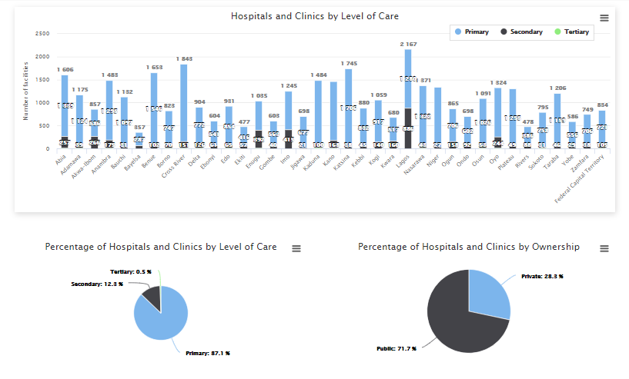
Summary charts

Slide 19
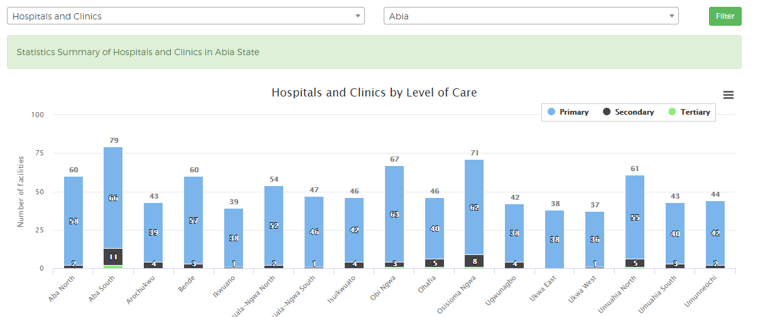
Summary charts: Filter
by state level

Slide 20
Facilities list

Slide 21
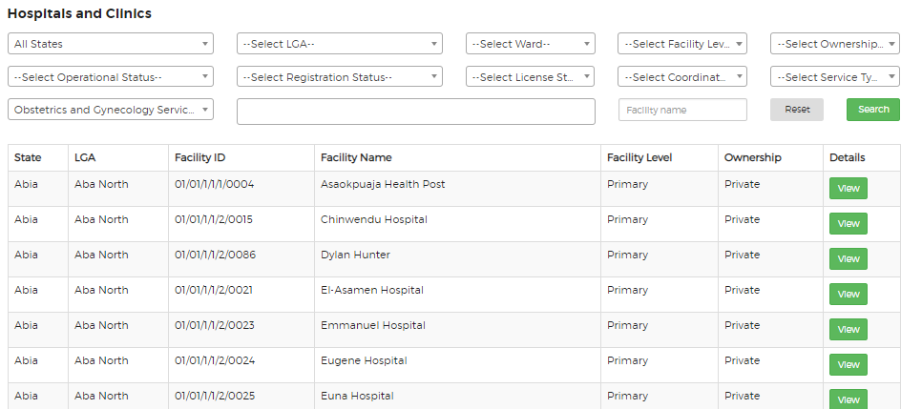
Facilities list
Click on the facilities list menu -> Hospitals and Clinics

Slide 22
Facilities list: Filter
You can filter facilities by
State
LGA
Ward
Level of care
Ownership
Operation status
Registration status
License status
Facilities with or without
coordinates
Service types
Service rendered
Facility name

Slide 23
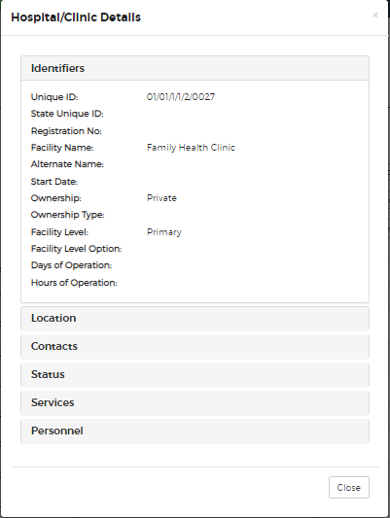
Facilities list: Details

Slide 24
Data downloads

Slide 25
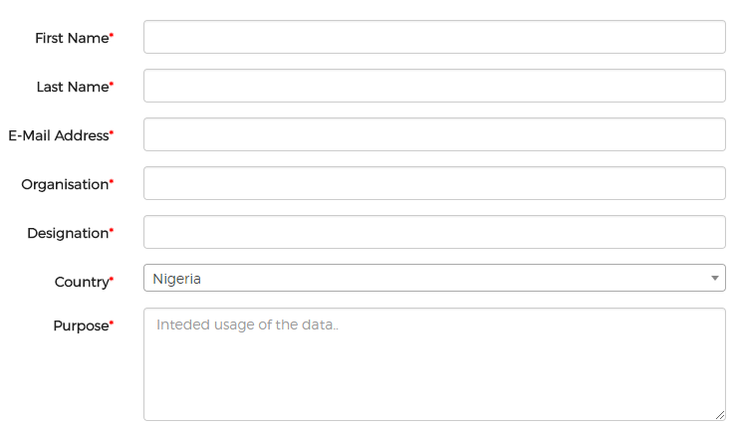
Data downloads
Thank you for your interest
For those requiring download of data in Excel format,
please complete the form and you will receive access to download the data you need.

Slide 26
Resources

Slide 27
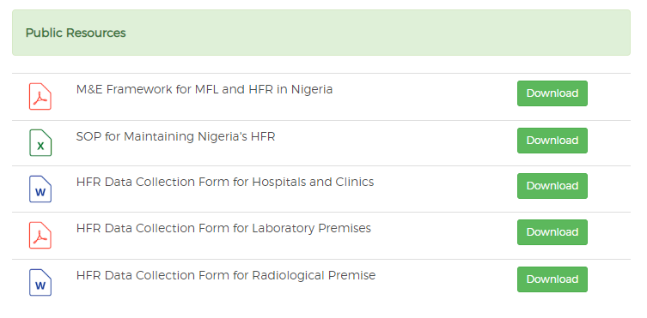
Resources
If you are looking for an MFL-related document, find the most current version available for download here.

